Slide 1
Parallelization in Molecular Dynamics
By Aditya Mittal
For CME346A by Professor Eric Darve
Stanford University

Slide 2
Parallelization Overview
In MD we would like to compute the velocities and positions of particles based on computing the interaction forces between millions of particles
This requires lots of computation but each computation is pretty much independent of all the other computations
The problem, however, is that interprocessor communication times are slow and so combining the results of each computation for a particle is slow

Slide 3
Parallelization Techniques
There are 3 Different Parallelization Techniques that can be adapted for the type of problem we are dealing with:
  Atom Decomposition
  Force Decomposition
  Space Decomposition
By type of problem I mean the aspects of the problem such as the number of particles in the simulation, the number of processors available for simulation, the type of potential to simulate and so on…

Slide 4
Atom Decomposition (AD)
Assign P processors to N atoms so each processor gets N/P atoms, load balancing is automatically achieved
Each processor will compute a sub-block of N/P rows of an NxN Force Matrix F throughout the simulation, where (i,j) entry is the force on ith atom due to jth atom
F is sparse because we only consider short range forces and is skew-symmetric because of Newton’s 3rd Law
The forces will be used to update the position vector x and velocity vector v of the different atoms
Clearly in this method each processor requires importing positions of many other atoms, maintained in “neighbor lists” to compute F and has high communication times, as all processors communicate with all other processors at each time step
Thus this method quickly becomes ineffective as we increase the number of processors

Slide 5
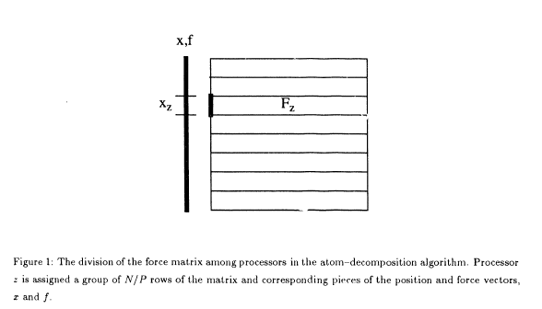

Slide 6
Force Decomposition (FD)
Notice that the inefficiency in AD came from having a row wise decomposition of the Force Matrix F
So in FD, instead we do a block decomposition of F’ (some permutation of F in order to preserve the ordering of the position vector x)
As with AD we create and keep neighbor lists, and for large number of atoms we generally maintain bins of neighboring atoms and check the 27 bins surrounding each atom (1 bin in which the atom is and 26 bins around the atom’s bin)

Slide 7
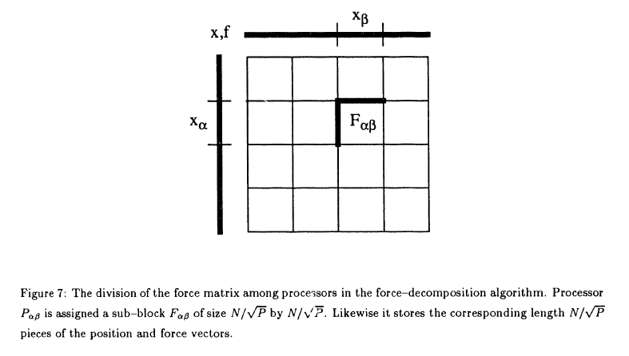

Slide 8
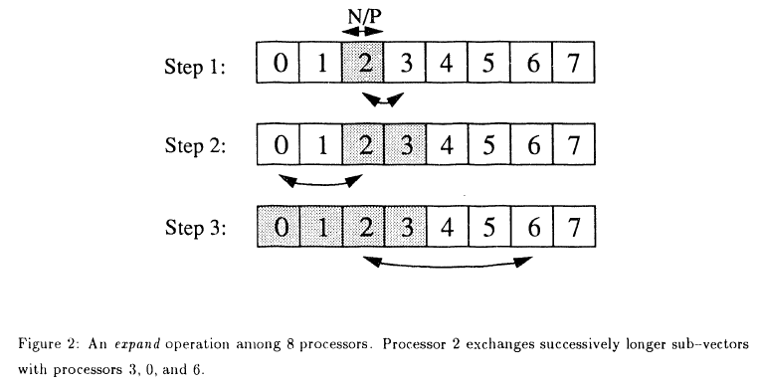
Expanding and folding 1
We use expanding and folding operations for the actual interprocessor communication
Here is an example of 8 processor expand used to distribute the positions to all other processors:

Slide 9
Expanding and folding 2
Folding is the inverse operation of expand
Suppose each processor now knows the new force values for its atoms and a processor needs to know the force value for an atom on another processor
Then it is able to do so in log(P) steps by splitting f in each step and sending the required part of f to its partner processor. This is the fold operation.

Slide 10
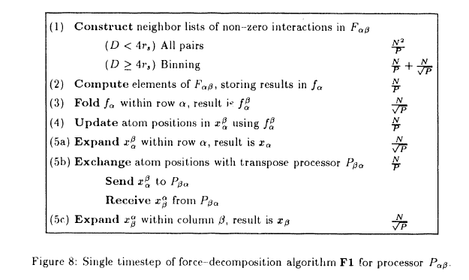
FD continued
Given the expand and fold operations for communicating the neighbor lists and forces we can now write a Force Decomposition algorithm

Slide 11
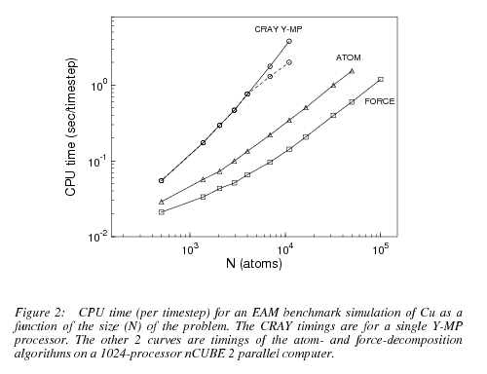
FD continued
Having seen the algorithm for FD it is then clear that AD’s O(N) scaling of the communication cost is improved to O(N/sqrt(P)) in the FD

Slide 12
Basic Technique for Space Decomposition
The basic idea here is to discretize the space of particles into cubes and let each processor do the computation for a cube
The cube in which a particle exists is called its “home box”
So, then to perform the total computations for a particle, the processor imports data for all the particles within a certain interaction radius, this is known as the “import region”
The particles outside the home box and import region are generally ignored from the calculation, or some other less intensive method may be used
SD is useful for adjusting short range forces since it is local as opposed to the global AD and FD

Slide 13
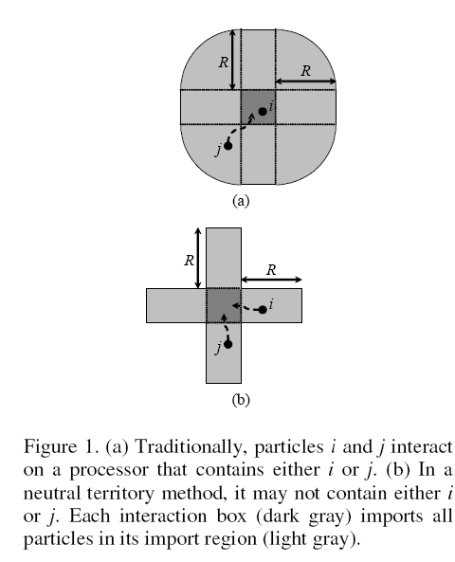

Slide 14
Limitations of the Traditional SD Technique
In the basic technique just discussed, there are significant limitations to the number of processors we can use because of the dependence on the interaction radius
In the limit as the number of processors gets large, each processor will have to import a lot of data and since interprocessor communication is slow and this is inefficient

Slide 15
DE Shaw’s Neutral Territory (NT) Method
DE Shaw’s idea is that instead of having a whole home box on one processor and then importing the import region to the processor, its better to make independent the processor from the home box
So, instead consider the 2D case where each box is a square on a grid, Shaw’s NT method assigns each box on the grid to a processor, and then processes the interactions of the particles in the ith row and jth column on the (i, j) processor
In general this method means we might have to import both particles to the nearest processor between the two, but we import both to the nearest processor in the grid and make the number of processors independent of the interaction radius

Slide 17
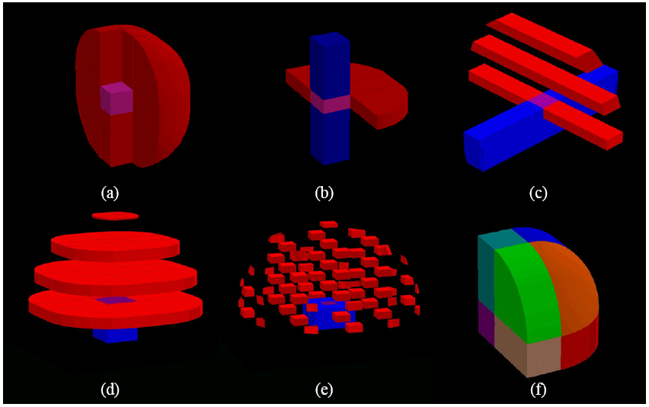
Notes:
Mention that these figures are half because they exploit symmetry of the interaction between the two particles
The first one is half shell method, described as the basic technique

Slide 18
CUTOFF
The “cutoff” radius defines the region in which we need to consider the interaction of particles, this works well for Lennard-Jones potential because it decays quickly as the distance increases
Coulomb potential generally is split into a real space and a k-space by assuming a periodic structure and using the Ewald method – the real space is analyzed using “cutoff” and the k-space is analyzed with a transform space since it is long range

Slide 19

Snir’s hybrid (SH) method
Space decomposition has less communication when cutoff c is small because it relies on locality
Force decomposition avoids expense of direct broadcast to a large number of processors
SH optimizes between the two types of decompositions using space when p < d/c and force when p > d/c, here p is number of particles and d is the side of the cubes forming the discretization
NT and SH scale asymptotically as as opposed to the traditional spatial decomposition method which scales as

Slide 20
Notes:
Mention that these figures are half because they exploit symmetry of the interaction between the two particles
The first one is half shell method, described as the basic technique

Slide 21
Using multiples zones
So far the methods talked about have 2 zones corresponding to the two particles whose interaction we considered, but often it is advantageous to compute interactions by having multiple zones as in the “eighth shell” method
The eighth shell method forms eight shells from the full import region around the home box and the home box interacts one at a time by each of the eight shells
This method is worse than NT in the limit of large number of processors, but has a smaller import region than any of the other known methods in the low parallelism limit
By having multiple zones we can work out in more detail exactly which zones really need to interact with which zones, often reducing the total amount of interaction to be computed

Slide 22
Benchmarking and Conclusion
Of the three types of parallelization algorithms, atom decomposition, force decomposition, and space decomposition the type of parallelization algorithm that is optimal varies from problem to problem based on the costs of things like
  Calculating the number of neighbors included in cutoff distance
  Calculating the forces depending on locality of potential etc.
  Building neighbor lists as functions of temperature, density, cutoff etc.
  Amount of Load balancing that is necessary, for example, there is no need for load balancing with the atom decomposition technique
Lammps by Sandia National Labs for example is a parallelization software optimized for massive parallelization and works by importing neighbor lists.

Slide 23
References
[1] Kevin J Bowers, Ron O Dror, and David E Shaw. Overview of neutral territory methods for the parallel evaluation of pairwise particle interactions.
[2] Marc Snir. A note on N-body computations with cutoffs. http://springerlink.metapress.com/content/hg2mg2nj9hf9gq6p/
[3] Steve Plimpton. Fast Parallel Algorithms for Short-Range Molecular Dynamics

Slide 24
Thank You.

